Slide 1

Working with Assistants Part 6: Managing Messages

Slide 2
Issey Miyake
“One of my assistants found this old German machine. It was originally used to make underwear. Like Chanel, who started with underwear fabric - jerseys - we used the machine that made underwear to make something else.”

Slide 3



Notes:
https://www.youtube.com/channel/UC35ZpwldGw7ZJ5R-2sLijzw

Slide 4


Membership has its privileges
Notes:
https://www.youtube.com/channel/UC35ZpwldGw7ZJ5R-2sLijzw/join

Slide 5
Listing Messages
Let’s see what we have!
Notes:
https://platform.openai.com/docs/api-reference/messages/listMessages

Slide 6
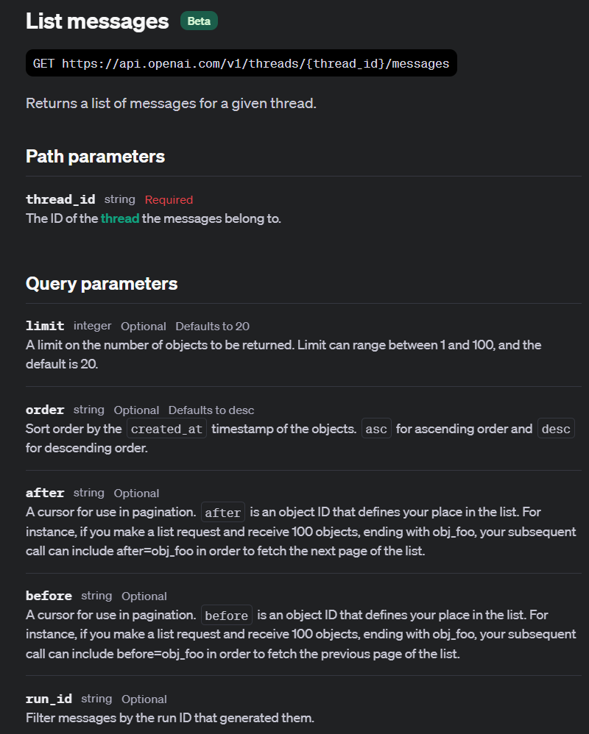

Slide 7
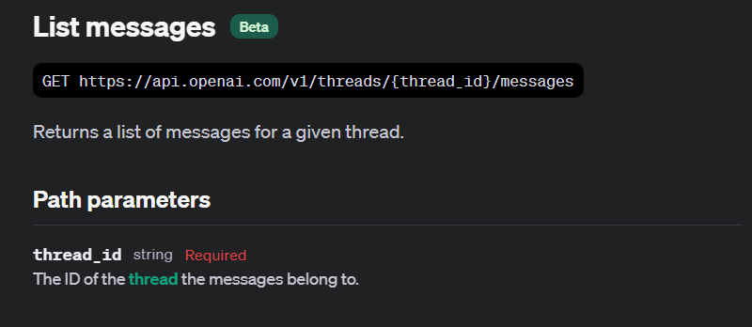
Notes:
https://platform.openai.com/docs/api-reference/messages/listMessages

Slide 8
Demo: Simple List of Messages in a Thread
from openai import OpenAI
# Initialize the client using the OpenAI library.
client = OpenAI()
# Retrieve a list of messages from a specific thread using its ID.
thread_messages = client.beta.threads.messages.list(thread_holding_messages.id)
print(thread_messages.data) # Print the raw data of messages
print("\n") # Print a newline for better readability of output
# Initialize a counter to keep track of the number of messages.
message_count = 0
# Iterate over each message in the list, printing details and counting them.
for message in thread_messages.data:
print(message.id) # Print the unique identifier of each message
print(message.role) # Print the role of the message sender
print(message.content) # Print the content of the message
print("\n") # Print a newline for separation between messages
message_count += 1 # Increment the message count

Slide 9
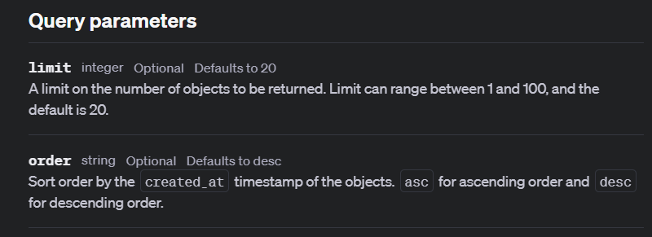

Slide 10
Demo: Limiting and Sorting Messages
from openai import OpenAI
# Initialize the client using the OpenAI library.
client = OpenAI()
# Retrieve a list of messages from a specific thread using its ID.
thread_messages = client.beta.threads.messages.list(
thread_id=thread_holding_messages.id,
limit=2, # Limit the number of messages retrieved to 2
order="desc", # Order the messages in descending order (most recent first)
)
print(thread_messages.data) # Print the raw data of messages

Slide 11
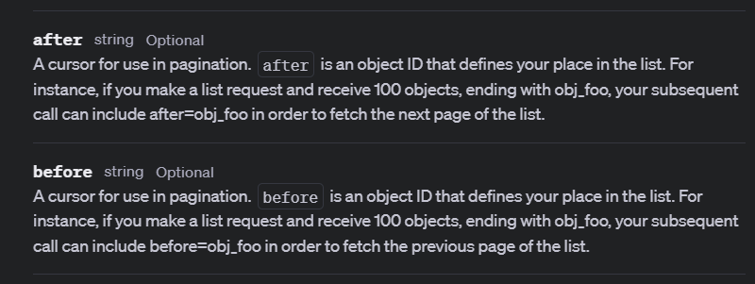

Slide 12
Demo: Pagination with Messages
# Import the OpenAI library
from openai import OpenAI
# Create an OpenAI client
client = OpenAI()
# Initialize the 'after_id' variable to track pagination
after_id = None
# Loop to fetch all pages of messages until no more data is available
while True:
# Retrieve a list of up to 2 messages, sorted from oldest to newest,
# starting after the previously retrieved message (if any)
thread_messages = client.beta.threads.messages.list(
thread_id=thread_holding_messages.id,
limit=2, # Limit the number of messages retrieved to 2
order="desc", # Order the messages in descending order (most recent first)
after=after_id # Include the after_id to fetch messages after the last retrieved ID

Slide 13
Retrieving Messages
Did You Save Your Thread ID & Message ID?
Notes:
https://platform.openai.com/docs/api-reference/messages/getMessage

Slide 14
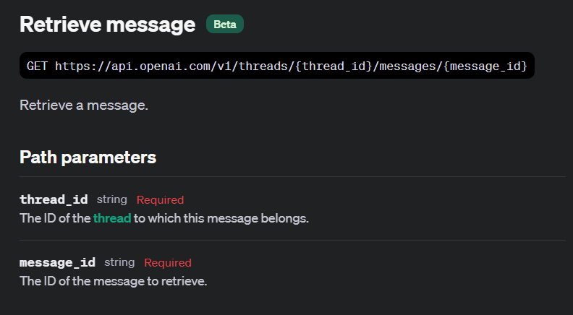

Slide 15
Demo: Retrieving Messages
from openai import OpenAI
# Initialize the OpenAI client.
client = OpenAI()
# Retrieve a specific message by its ID from a given thread.
fetched_message = client.beta.threads.messages.retrieve(
thread_id=thread_holding_messages.id, # ID of the thread containing the message
message_id=message.id, # ID of the message to retrieve
)
# Print the retrieved message object to see its details.
print(fetched_message)

Slide 16
Modifying Messages
Ch-ch-ch-changes!
Notes:
https://platform.openai.com/docs/api-reference/messages/modifyMessage

Slide 17
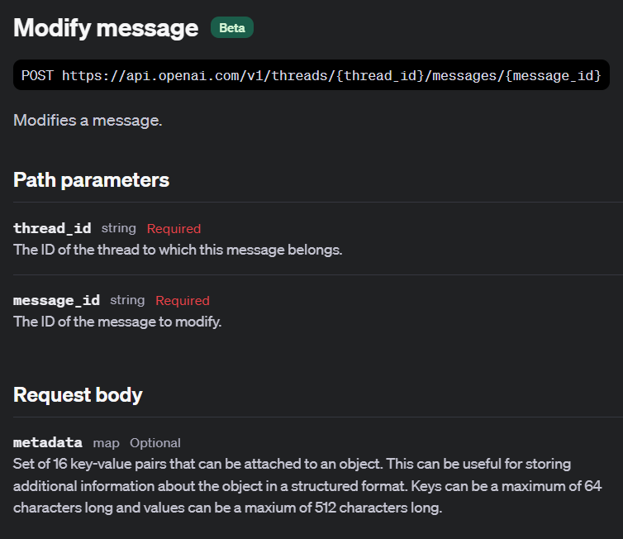

Slide 18
Demo: Modifying Messages
from openai import OpenAI
# Initialize the OpenAI client.
client = OpenAI()
# show the before data
print(f"Before Update: {message}")
print("\n")
# Update a specific message by its ID within a given thread.
modified_message = client.beta.threads.messages.update(
thread_id=thread_holding_messages.id, # ID of the thread containing the message
message_id=message.id, # ID of the message to update
metadata={ # Metadata to add or update for the message
"modified": "true",
"user": "abc123",
},
)
# Print the modified message object to view its updated details.
print(modified_message)

Slide 19
Deleting Messages
Seriously, Clean Up After Yourself
Notes:
https://platform.openai.com/docs/api-reference/messages/deleteMessage

Slide 20
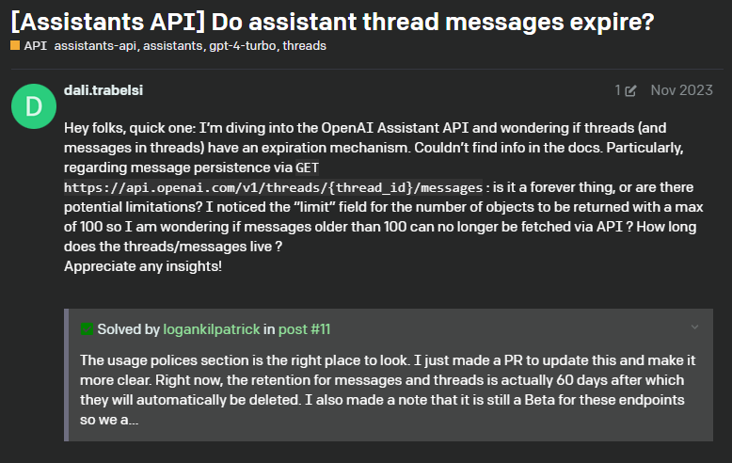
Thread/Message Expiration
Notes:
https://community.openai.com/t/assistants-api-do-assistant-thread-messages-expire/487558

Slide 21
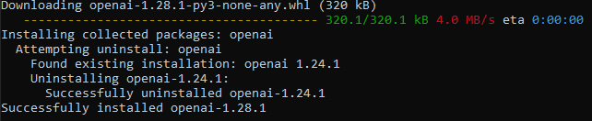
# You may need to upgrade to the latest version of the OpenAI library to use the delete method.
# If you encounter an error, consider upgrading the library using 'pip install openai --upgrade'
# !pip install openai --upgrade

Slide 22
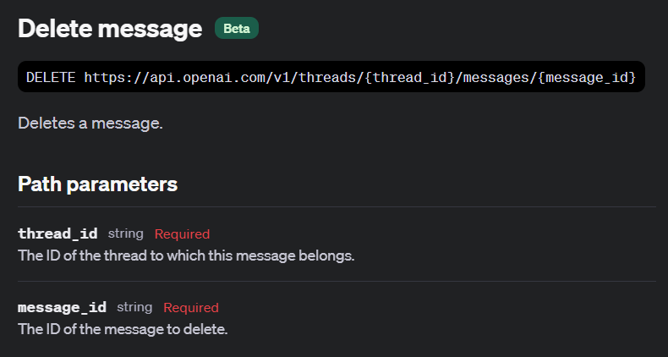

Slide 23
Demo: Delete Messages
from openai import OpenAI
# Initialize the OpenAI client.
client = OpenAI()
try:
# Delete a specific message by its ID within a given thread.
deleted_message = client.beta.threads.messages.delete(
thread_id=thread_holding_messages.id,
message_id=message.id
)
# Print the result of the delete operation to verify its success.
print("Message deleted successfully:", deleted_message)
except NotFoundError as e:
# Handle the case where the message does not exist
print("The message could not be found and thus not deleted. Error:", str(e))

Slide 24


